Slide 1
CS4031 Compiler Construction Chapter 4 cont.
Faryal Saud
Lecturer, Department of Computer Science
FAST NUCES CFD

Slide 2
Ambiguity Removal
The ambiguity removal is important in the grammar which consist of
Logical Operators
Arithmetic Operators
If else statement
Regular expressions operators

Slide 3
Arithmetic Operators
The two basic Properties of ambiguity removals are
Precedence
Associativity
Associativity
+, - | Left to right | Keep left recursion
*, / | Left to right | Keep left recursion
^ | Right to left | Keep right recursion
id/terminal | -
Precedence
+, - | 4
*, / | 3
^ | 2
Id/terminals | 1

Slide 4
Logical Operators
The two basic Properties of ambiguity removals are
Precedence
Associativity
Associativity
˅ | Left to right | Keep left recursion
˄ | Left to right | Keep left recursion
~ | Right to left | Keep right recursion
id/terminal | - | -
Precedence
˅ | 4
˄ | 3
~ | 2
Id/terminals | 1

Slide 5

Example
Ambiguous Grammar
Unambiguous Grammar
$$E→E ˄E \left| E ˅ E \right| \sim E \left| \left(E\right)\right|id$$
$E→E ˅ E_{1}|E_{1}$
$${ E}_{1} →E_{1} ˄E_{2}|E_{2}$$
$${ E}_{2} → \sim E_{2} |E_{3}$$
$$E_{3 }→\left(E\right) | id$$

Slide 6
Regular Expression Operators
The two basic Properties of ambiguity removals are
Precedence
Associativity
Precedence
Union | 4
Concatenation | 3
Kleene star | 2
Id/terminals | 1
Associativity
Union | Left to right | Keep left recursion
Concatenation | Left to right | Keep left recursion
Kleene star | - | -
id/terminal | - | -

Slide 7


Regular Expression Operators Example
Ambiguous Grammar
Unambiguous Grammar
$$E→E+E \left| EE \right| E^{∗} | id$$
$E→E+ E_{1}|E_{1}$
$${ E}_{1} →E_{1} E_{2}|E_{2}$$
$${ E}_{2} → E_{2}^{∗}|E_{3}$$
$$E_{3 }→ id$$

Slide 8
If- else Problem
Consider the following Grammar
S → if E then S | if E then S else S | other
Where
E represent the Expression
S represent the Statement

Slide 9
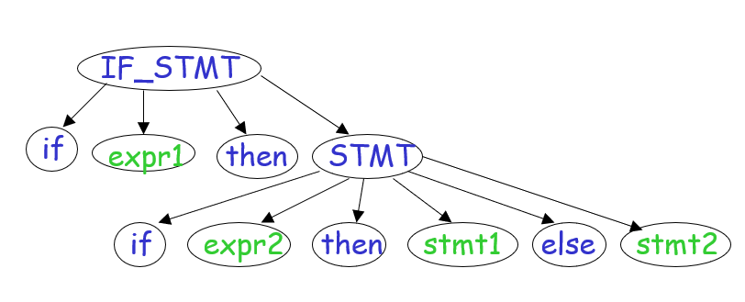
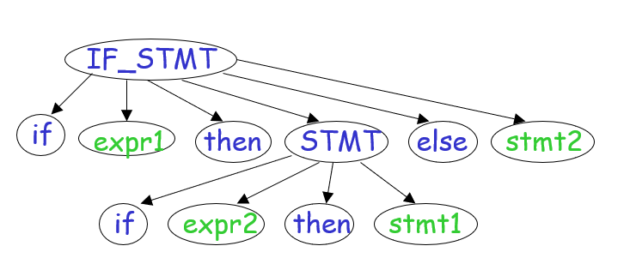
Parse Tree

Slide 10
If else Statements
Matched statements
It is either a non-if statement, or a complete if-then-else statement.
Open statements
It is either a if-then statement (without else), or it is a if-then-else statement but the else-statement is an open statement.

Slide 11
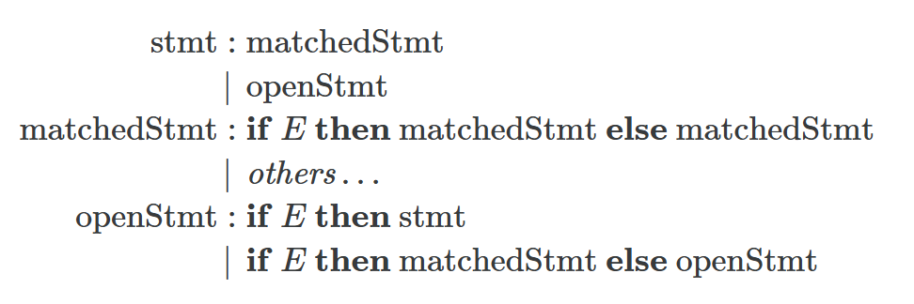
Unambiguous grammar

Slide 12
Example
if E1 then if E2 then S1 else S2
Can you construct two distinct parse tree for it?

Slide 13
Parsing Technique
Parser
Top-Down Parser
Recursive Descent Parser
LL(1) Parser
Bottom-Up Parser
LR Parser
Operator Precedence Operator
LL(0)
SLR(1)
LALR(1)
CLR(1)
Notes:
LL1 parser is also known as predictive parser

Slide 14
Parser
Top-Down Parser Top- Down parser starts constructing the parse tree from the start symbol and then tries to transform the start symbol to the input, it is called top-down parsing.
Bottom-Up Parser bottom-up parsing starts with the input symbols and tries to construct the parse tree up to the start symbol.

Slide 15
Top-Down Parser
Top-Down Parser
Recursive Descent
LL(1) Parser
Back tracking
Non-Backtracking Parser
Predictive Parser

Slide 16
Recursive Descent Parser
Recursive Descent Parsing is a top-down method of syntax analysis in which s set of recursive procedures to process the input is executed.
A procedure is a associated with each nonterminal of a grammar.
Top-down parsing can be viewed as an attempt to find a leftmost derivations for an input string.
Recursive descent parsing involves backtracking.

Slide 17
Example
Consider the following grammar
S → cAd
A → ab | a
And the input string w = cad.

Slide 18
Solution
S
c
A
d
S
c
A
d
a
S
c
A
d
a
b

Slide 19
Top Down Parser
In top down parser we have two types of parser
Recursive Descent
LL(1) Parser
First L represent the direction of look a head pointer.
L represent the type of derivation.
1 means how many symbol we read from the string.
LL means we used left to right derivation and making the left most derivation tree.

Slide 20
Condition of LL(1) Parser
To construct a working LL(1) parsing table, a grammar must satisfy these conditions:
No Left Recursion: Avoid recursive definitions like A -> A + b.
Unambiguous Grammar: Ensure each string can be derived in only one way.
Left Factoring: Make the grammar deterministic, so the parser can proceed without guessing.

Slide 21
LL(1) Parser
The rules for LL(1) parsers are
Remove left Recursion
Remove Left Factoring
Find the first and follow of the grammar
Create Parse Table
Create Parse tree

Slide 22
Example: Check whether the grammar is LL(1) or not.
E → TE'
E' → +TE' | ε
T → FT'
T' → *FT' | ε
F → id | (E)
*ε denotes epsilon

Slide 23
First of Grammar
E → TE'
E' → +TE' | ε
T → FT'
T' → *FT' | ε
F → id | (E)
Grammar Production Rule | Non-Terminals | First
E → TE' | E
E' → +TE' | ε | E`
T → FT' | T
T' → *FT' | ε | T`
F → id | (E) | F

Slide 24
First of Grammar
Grammar Production Rule | Non-Terminals | First
E → TE' | E | {id,( }
E' → +TE' | ε | E` | {+, ε}
T → FT' | T | {id, ( }
T' → *FT' | ε | T` | {*, ε}
F → id | (E) | F | {id, (}

Slide 25
Follow of the Grammar
Grammar Production Rule | Non-Terminals | Follow
E → TE' | Follow of (E) | ($, ) }
E' → +TE' | ε | E`
T → FT' | T
T' → *FT' | ε | T`
F → id | (E) | F
Must Remember the follow of first symbol must have $

Slide 26
Follow of the Grammar
Grammar Production Rule | Non-Terminals | Follow
E → TE' | Follow of (E) | {$, ) }
E' → +TE' | ε | Follow of E` | {$, ) }
T → FT' | Follow of T = First of E` | {+, $, )}
T' → *FT' | ε | Follow of T` = follow of T | {+, $, )}
F → id | (E) | Follow of F = first of T` | {*,+, $, )}
Must Remember the follow of first symbol must have $

Slide 27
Parsing Table
Grammar Production Rule | First | Follow
E → TE' | {id,( } | {$, ) }
E' → +TE' | ε | {+, ε} | {$, ) }
T → FT' | {id, ( } | {+, $, )}
T' → *FT' | ε | {*, ε} | {+, $, )}
F → id | (E) | {id, (} | {*,+, $, )}
Add all follow symbols in column
Add the variable symbols in row
 | id | + | * | ( | ) | $
E | E → TE’ |  |  | E → TE'
E` |  | E' → +TE' |  |  | E' → ε | E' → ε
T | T → FT' |  |  | T → FT'
T` |  | T' → ε | T' → *FT' |  | T' → ε | T' → ε
F | F → id |  |  | F → (E)
If the first any variable is ε then move towards the follow of that variable.

Slide 28
Create the Parser Tree of the following id+ id * id

Slide 29
Stack Implementation
Given Expression
id + id * id $
Given Grammar
E → TE'
E' → +TE' | ε
T → FT'
T' → *FT' | ε
F → id | (E)

Slide 30
Stack Implementation
E
$
id + id * id $
 | id | + | * | ( | ) | $
E | E → TE’ |  |  | E → TE'
E` |  | E' → +TE' |  |  | E' → ε | E' → ε
T | T → FT' |  |  | T → FT'
T` |  | T' → ε | T' → *FT' |  | T' → ε | T' → ε
F | F → id |  |  | F → (E)

Slide 31
Stack Implementation
T
E`
$
id + id * id $
 | id | + | * | ( | ) | $
E | E → TE’ |  |  | E → TE'
E` |  | E' → +TE' |  |  | E' → ε | E' → ε
T | T → FT' |  |  | T → FT'
T` |  | T' → ε | T' → *FT' |  | T' → ε | T' → ε
F | F → id |  |  | F → (E)

Slide 32
Stack Implementation
F
T`
E`
$
id + id * id $
 | id | + | * | ( | ) | $
E | E → TE’ |  |  | E → TE'
E` |  | E' → +TE' |  |  | E' → ε | E' → ε
T | T → FT' |  |  | T → FT'
T` |  | T' → ε | T' → *FT' |  | T' → ε | T' → ε
F | F → id |  |  | F → (E)

Slide 33
Stack Implementation
id
T`
E`
$
id + id * id $
id
 | id | + | * | ( | ) | $
E | E → TE’ |  |  | E → TE'
E` |  | E' → +TE' |  |  | E' → ε | E' → ε
T | T → FT' |  |  | T → FT'
T` |  | T' → ε | T' → *FT' |  | T' → ε | T' → ε
F | F → id |  |  | F → (E)

Slide 34
Stack Implementation
T`
E`
$
id + id * id $
id
 | id | + | * | ( | ) | $
E | E → TE’ |  |  | E → TE'
E` |  | E' → +TE' |  |  | E' → ε | E' → ε
T | T → FT' |  |  | T → FT'
T` |  | T' → ε | T' → *FT' |  | T' → ε | T' → ε
F | F → id |  |  | F → (E)

Slide 35
Stack Implementation
ε
E`
$
id + id * id $
id
 | id | + | * | ( | ) | $
E | E → TE’ |  |  | E → TE'
E` |  | E' → +TE' |  |  | E' → ε | E' → ε
T | T → FT' |  |  | T → FT'
T` |  | T' → ε | T' → *FT' |  | T' → ε | T' → ε
F | F → id |  |  | F → (E)

Slide 36
Stack Implementation
E`
$
id + id * id $
id
 | id | + | * | ( | ) | $
E | E → TE’ |  |  | E → TE'
E` |  | E' → +TE' |  |  | E' → ε | E' → ε
T | T → FT' |  |  | T → FT'
T` |  | T' → ε | T' → *FT' |  | T' → ε | T' → ε
F | F → id |  |  | F → (E)

Slide 37
Stack Implementation
+
T
E`
$
id + id * id $
id
 | id | + | * | ( | ) | $
E | E → TE’ |  |  | E → TE'
E` |  | E' → +TE' |  |  | E' → ε | E' → ε
T | T → FT' |  |  | T → FT'
T` |  | T' → ε | T' → *FT' |  | T' → ε | T' → ε
F | F → id |  |  | F → (E)

Slide 38
Stack Implementation
F
T`
E`
$
id + id * id $
id +
 | id | + | * | ( | ) | $
E | E → TE’ |  |  | E → TE'
E` |  | E' → +TE' |  |  | E' → ε | E' → ε
T | T → FT' |  |  | T → FT'
T` |  | T' → ε | T' → *FT' |  | T' → ε | T' → ε
F | F → id |  |  | F → (E)

Slide 39
Stack Implementation (Complete Table)
MATCHED | STACK | INPUT | ACTION
 | E$ | id + id * id$ | E → TE’
 | TE`$ | id + id * id$ | T → FT’
 | FTE`$ | id + id * id$ | F→ id
 | ididT`E$ | id + id * id$ | Match id
id | T`E$ | + id * id$ | T` → epsilon
id | E`$ | + id * id$ | E` → +TE`
id | +TE`$ | + id * id$ | Match +
id+ | TE`$ | id * id$ | T → FT`
id+ | FT`E`$ | id * id$ | F → id
id+ | idT`E`$ | id * id$ | Match id
id+ id | T`E`$ | * id$ | T’ → *FT`
id+ id | FT`E$ | * id$ | Match *
id+ id * | FT`E`$ | id$ | F → id

Slide 40
Stack Implementation
MATCHED | STACK | INPUT | ACTION
id+ id * | Id T`E`$ | Id $ | F → id
id+ id * id | T`E`$ | $ | Match id
id+ id * id | E`$ | $ | T` → epsilon
id+ id * id | $ | $ | E` → epsilon

Slide 41
Parse Tree
E
T
F
id
T`
ε
E`
+
T
F
id
T`
*
F
id
T`
ε
E`
ε

Slide 42
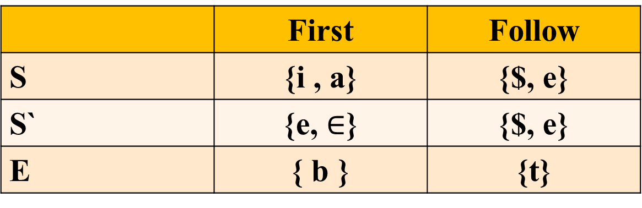
Example 2: Draw the LL(1) parsing table for the given grammar ?
S → iEtSS’ | a
S' → eS | ℇ
E → b
 | First | Follow
S | {i , a} | {$, e}
S` | {e, $∈$} | {$, e}
E | { b } | {t}

Slide 43
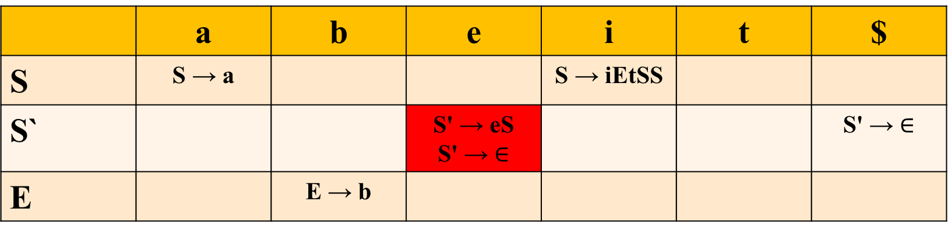
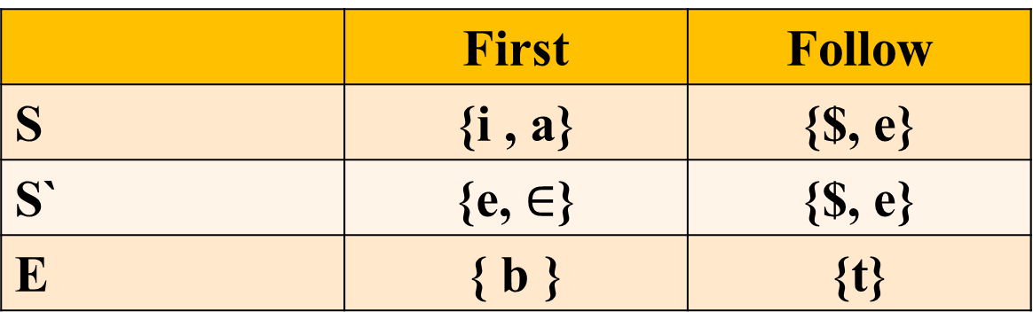
Solution:
 | First | Follow
S | {i , a} | {$, e}
S` | {e, $∈$} | {$, e}
E | { b } | {t}
S → iEtSS’ | a
S' → eS | ℇ
E → b
 | a | b | e | i | t | $
S | S → a |  |  | S → iEtSS
S` |  |  | S' → eS S' → $∈$ |  |  | S' → $∈$
E |  | E → b
This grammar is not feasible for LL(1) Parser.

Slide 44
Example 3: Draw the LL(1) parsing table for the given grammar ?
S → aABb
A → c | ε
B → d | ε

Slide 45
Example 4: Draw the LL(1) parsing table for the given grammar ?
S → W
W → ZXY
Y → c | ε
Z → a | d
X → Xb | ε

